Slide 1

Object Oriented Programming BE(CSE) II-Semester
Prepared by
S. Durga Devi,
Assistant Professor,
CSE,CBIT
S. Durga Devi ,CSE,CBIT

Slide 2
Unit-V
Error and Exception Handling:
Introduction to errors and exceptions
Handling Exceptions
GUI Programming
Simple GUI Programming with tkinter package
Sample Graphics using Turtle
Plotting Graphs in Python.
S. Durga Devi ,CSE,CBIT

Slide 3
Introduction to Exception Handling
If you consider any programming language has two types of errors.
Syntax error
Runtime error
Syntax error:
Errors due to invalid syntax.
Ex:
print ‘hai’ # gives syntax error missing parenthesis in call to print
- Syntax errors are fixed by programmer, once fixed program can be executed normally.
2. Runtime error: (exceptions)
- Errors during Runtime of the program.
Ex: print(10/0) # ZeroDivisionError: division by zero
print(10/x) # NameError: name 'x' is not defined.
Exception handling is applicable for the handling the run time errors only not for the syntax errors.
S. Durga Devi ,CSE,CBIT

Slide 4
Introduction to Exception Handling
What is an Exception?
Exception is a run time error.
An unwanted, unexpected event that disturbs normal flow of the program is called Exception.
ex- our program requirement is read the data from a remote file located in Landon. At runtime if Landon file is not available program is terminated abnormally
exception is that FileNotFoundError.
Is it recommended to handle exception?
- it is highly recommended to handle exceptions under the main objective of Exception Handling.
What is an Exception Handling?
Graceful termination of the program.
defining an alternative way to continue rest of the program execution normally.
S. Durga Devi ,CSE,CBIT

Slide 5
If any thing went wrong we should not miss or lose anything.
Concept of exception handling is to provide alternative way to continue flow of execution normally without losing anything.
try:
read data from a file located at Landon
except:
use local file and continue rest of the program normally
If the Landon file not available our program should not be terminated abnormally.
we have to provide some local file to continue rest of the program normally. This is nothing but Exception Handling.
Exception handling does not fix the run time error. It provides the alternative way to continue the execution of rest of the program.
S. Durga Devi ,CSE,CBIT

Slide 6
Benefits of exception handling
Exception handling is used to continue the flow of execution without terminating the program abnormally when run time error is encounter.
Provides alternative way to continue the program execution normally(grace full termination of program)
Separates the error code and regular code using try and except blocks.
S. Durga Devi, CSE,CBIT

Slide 7
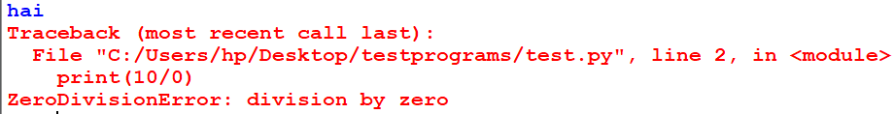
Default exception handling in python
Every exception in a python is an object. Every exception has a corresponding class.
Example:
print(‘hai’)
print(10/0)
print(‘hello cse1’)
When the exception raised in python, python virtual machine(PVM) creates
corresponding exception object and checks for the exception handling code in the
program. If no handling code in the python, python interpreter terminates the
program abnormally and gives the exception report to the program. Then rest of the
program will not be executed.
S. Durga Devi ,CSE,CBIT

Slide 8
Your second semester started in January right , your classes are going smoothly without any disturbances. You appeared mid-1 exam also.
Suddenly covid-19 came to picture which disturbed not only your classes. It has been shaking entire world. To save the people from covid-19 our pm and cm announced lockdown for three weeks.
all students felt very happy no college, no classes, no travelling nothing. You all enjoyed for week.
Due to lock down we are unable to run the classes. So covid is an exception because of it our college is not running so no classes.
What is the solution to run the classes – conduct online classes.
we are handling this lock down period by conducting online classes.
Conducting online classes with out interrupting the classes is the exception handling.
S. Durga Devi ,CSE,CBIT

Slide 9
Exception is a base class for all exceptions
Built in Exception in python
AttributeError- attribute assignment or reference fails
ImportError- module not found
NameError- when a variable not found in local or global space.
ZeroDivisionError- when a number divides with zero.
ValueError: when a function receives a correct type but inappropriate value.
import math
math.sqrt(-10)
S. Durga Devi ,CSE,CBIT

Slide 10
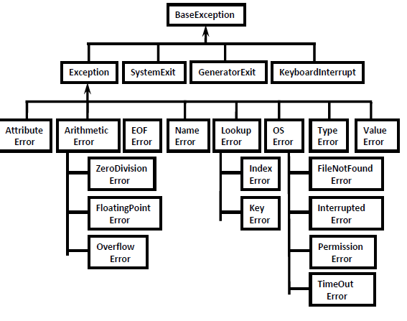
Exception hierarchy
https://www.youtube.com/watch?v=UtT_LaEBimU&list=PLd3UqWTnYXOlBZgb711WywNSHPsJIedtU&index=3
S. Durga Devi ,CSE,CBIT

Slide 11
Handling exceptions( try,except,finally)
try ,except and finally keywords are used to handle exceptions.
Syntax:
Where, risky code means- code that raises the exception
handling code – alternative way.
Note: using finally block is optional.
try:
riskycode
except Exceptionclass:
handling code
finally:
cleanup code
S. Durga Devi ,CSE,CBIT

Slide 12
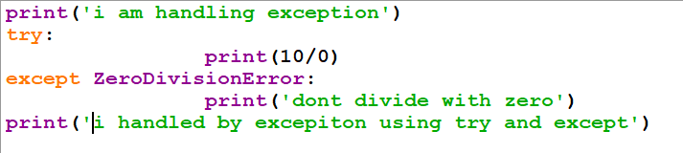

try and except example
Program terminated normally though exception raised.
S. Durga Devi ,CSE,CBIT

Slide 13
Control flow in try and except
tryblock
Is exception ?
No
Yes
Executes except block
Executes finally block
S. Durga Devi ,CSE,CBIT

Slide 14
In which order statements are executed if exception rised?
Case1:- no exception
1,2,3&5 are executed
Case2:- if exception rised at statement2
1,4,5 are executed.
once it comes out of try block control never goes
back. Rest of the try block never executed
so write only risky code inside of the try block.
Case 3:- if exception rised at statement4
exceptions can be rised in exceptand finally blocks
also sometimes
- causes abnormal termination.
Case4:- if exception rised in try block and
corresponding except block is not present
- causes abnormal termination.
try:
statement1;
statement2;
statement3;
except:
statement4;
statement5;
Note
within the try block if any where an exception rised then the rest of try block wont be executed even though we handled that exception.
hence within the try block we have to take only risky code and length of the try block should be as less as possible.
S.Durga Devi,CSE,CBIT

Slide 15
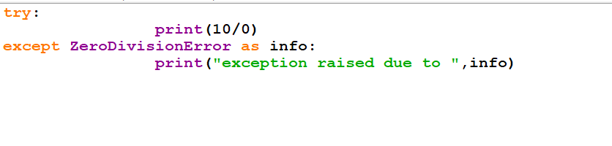
How to print the exception information ?
S. Durga Devi ,CSE,CBIT

Slide 16
try with multiple except blocks
If programmer does not know what type exception will rise in the code then go for the multiple except blocks.
For every exception a separate except block is to be defined.
When exception is thrown, each except block is inspected in order, and the first one which matches with the type of exception that except block will be executed.
When multiple except blocks used in a program you must remember in which order exception types should be specified for except block.
Exception subclasses should come before its super class exceptions why because except statement which has super class will handle all its sub classes exceptions .
It never give chance to handle for its sub class
S. Durga Devi ,CSE,CBIT

Slide 17
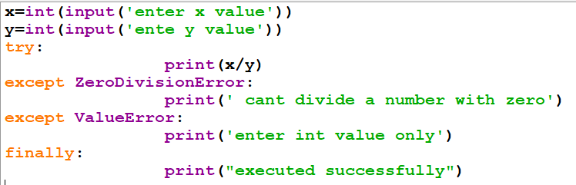
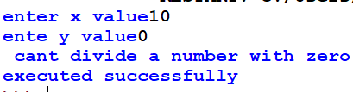

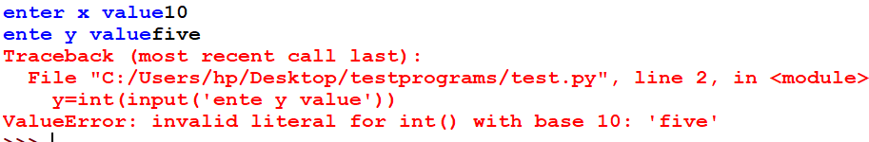
Example on multiple except blocks
testcase2
testcase1
testcase3
S. Durga Devi ,CSE,CBIT

Slide 18
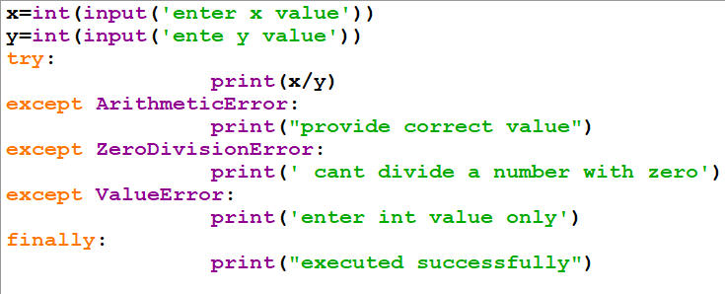

Exception subclasses should come before its super class exceptions why because except statement which has super class will handle all its sub classes exceptions .
It never give chance to handle for its sub class
S. Durga Devi ,CSE,CBIT

Slide 19
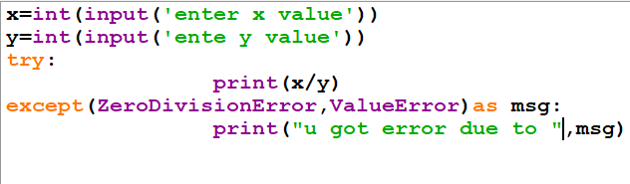
Single except block handles multiple exceptions
A single except block can handle multiple exceptions using following syntax.
Syntax:
except(exception1,exception2,……) or
except(exception1,exception2,…..) as info
Note: parenthesis is must and will consider internally as tuple
S. Durga Devi ,CSE,CBIT

Slide 20
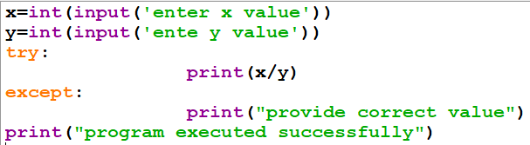
Default except block
To handle any type of error we can use default except block.
Syntax:
except:
statement
Note: If try with multiple except blocks available then default except block should be last,otherwise we will get SyntaxError.
S. Durga Devi ,CSE,CBIT

Slide 21
How many ways we can use except block
except ValueError:
except ValueError as info:
except(ValueError,TypeError):
except(ValueError,TypeError) as info
except:
S. Durga Devi ,CSE,CBIT

Slide 22
finally keyword
finally keyword.
finally is a block always associated with try and except to maintain clean up code.
What is specialty of finally?
finally block is always executed irrespective of whether exception is rised or not rised and whether handled or not handled.
- whatever resources are allocated in the try block can be deallocated by finally block.
General form of finally.
try:
risky code
except:
handling code
finally:
clean up code
S. Durga Devi ,CSE,CBIT

Slide 23
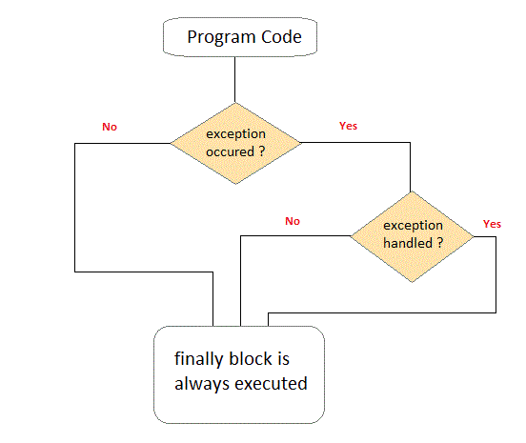
finally block
S. Durga Devi ,CSE,CBIT

Slide 24

Case study where finally block is more useful
Suppose open a file in read mode and read first line of a file and display it.
1. f=open(‘test.py’,’r’)
2. data=f.readline()
3. print(dat)# NameError
4. f.close()
in above code exception at line no 3. file unable to close. Then use finally block.
output
S. Durga Devi ,CSE,CBIT

Slide 25
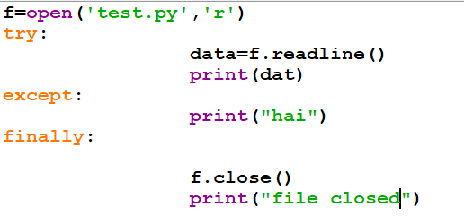
finally example
Output
hai
file closed
S. Durga Devi ,CSE,CBIT

Slide 26
Nested try-except-finally blocks:
We can define try-except-finally blocks inside the try, except and finally blocks i.e nested try-except-finally blocks.
try:# outer try block
st1
st2
try: #inner try block
st3
except:
st4
finally:
st5
except:
st6
finally:
st7
st8
when exception rised in inner try block,
inner except block will handle exception.
If inner except block unable to handle,
then outer except block will handle.
S. Durga Devi ,CSE,CBIT

Slide 27
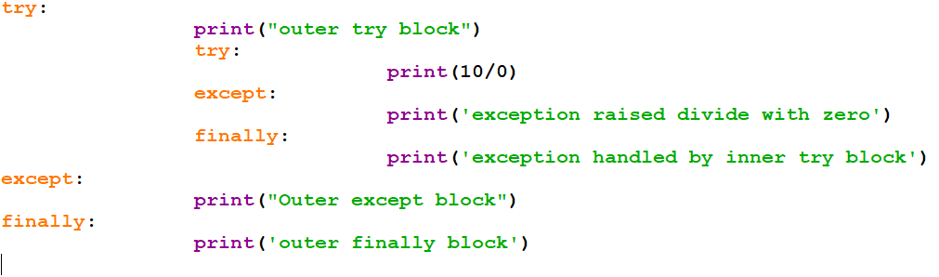
Example on nested try-except-finally
S. Durga Devi ,CSE,CBIT

Slide 28
else clause with try-except-finally
Along with try-except-finally blocks we can also use else clause.
else block will be executed when try block does not rise the exception.
Syntax:
try:
errorcode
except:
executed when exception rised
else:
executed when no exception
finally:
executed irrelevant of the exception
S. Durga Devi ,CSE,CBIT

Slide 29
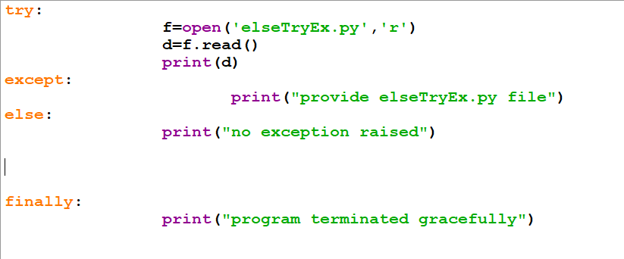
Example on else clause
- if elseTryEx.py file available no exception raised in try block then else block will be
executed.
- if exception raised else block will not be executed.
S. Durga Devi ,CSE,CBIT

Slide 30
Types of exceptions
There are two types of exceptions in python
predefined\built in exceptions
User defined exceptions\customized exceptions.
Predefined exceptions:
- when the exception raised in python program, python virtual machine creates exception object and stops the program execution and gives the information to the programmer.
Ex: ZeroDivisionError, ValueError, TypeError etc.
S. Durga Devi ,CSE,CBIT

Slide 31
2. user defined exceptions
- user or programmer can raise his own exceptions explicitly to deal with common problems such as
a) attempting to enter invalid PIN in ATM transactions.-InvalidPinError
b) attempt to enter negative salary for an employee- NegativeSalaryError
c) attempt to enter wrong username and password- WrongDetailsError
d) attempt to withdraw more amount than existing.-InsufficientFundsError
S. Durga Devi ,CSE,CBIT

Slide 32
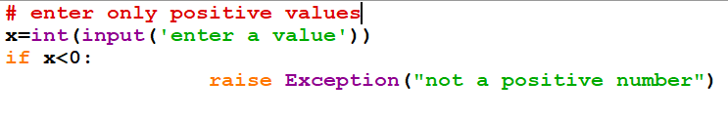
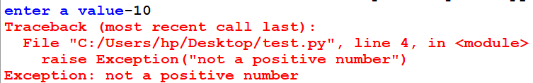
raise exceptions by user
‘ raise’ statement is used to raise the exceptions forcefully by the user rather than python virtual machine.
Example
S. Durga Devi ,CSE,CBIT

Slide 33
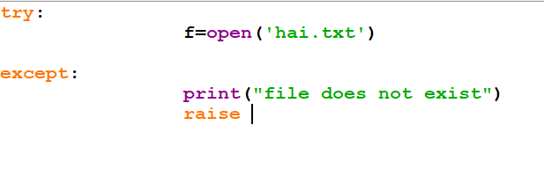
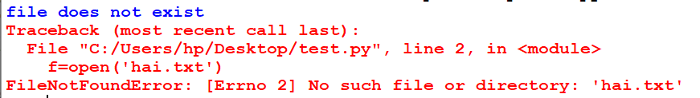
Re-raise the exception
We can also reraise the excpetion. This will be used when exception raised you dont intend to handle it.
S. Durga Devi ,CSE,CBIT

Slide 34
How to define and raise customized exceptions
Exception is super class for all the exceptions in python.
User defined exceptions are defined by create a class that extends Exception class.
Raise the exception using keyword ‘raise’.
raise is used to forcefully raise the exception by the user.
Syntax:
class classname(Exception):
def __init__(self,msg):
self.msg=msg
S. Durga Devi ,CSE,CBIT

Slide 35
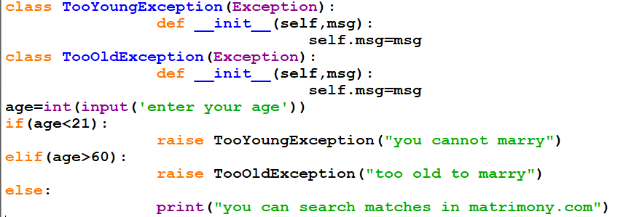
Example on customized exceptions
S. Durga Devi ,CSE,CBIT

Slide 36
Customized exception handling
class TooYoungError(Exception): pass class TooOldError(Exception): pass try: age=int(input("Enter your age")) if(age<21): raise TooYoungError elif(age>60): raise TooOldError else: print("you can marry now") except TooYoungError: print("you are too young to marry") except TooOldError: print("you are too old to marry")
S. Durga Devi ,CSE,CBIT

Slide 37
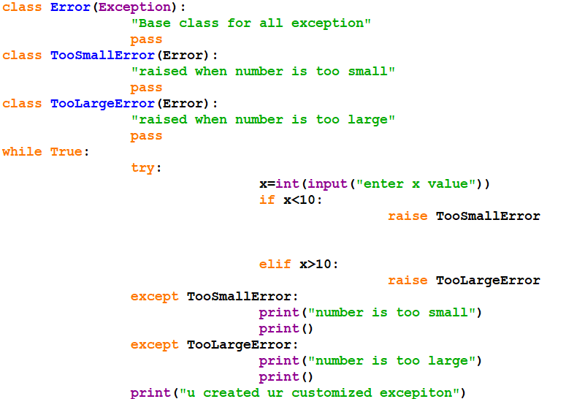
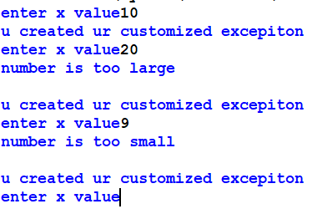
User defined exceptions
Every user defined class must extends base class Exception
Exception is base class for all the exceptions
output
S. Durga Devi, CBIT, CSE

Slide 38
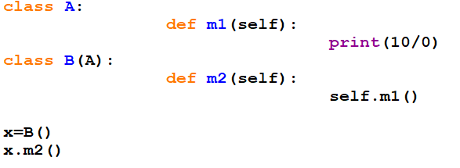
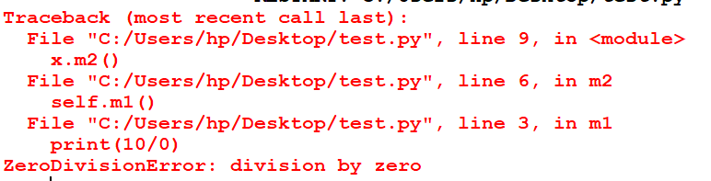
Traceback in python
Traceback maintains the function calls report in the program
Also called stack trace.
When exception raised in the program python virtual machine prints traceback to help you to know what went wrong in your program.
S. Durga Devi ,CSE,CBIT

Slide 39
Assertions in python
Assertions are used for the debugging purposes.
Debugging is process of finding and fixing bugs.
Two types of assertions
Simple version
Augmented version
1. Simple version
assert conditional_expression
2. augmented version
assert conditinal_ expression, msg
conditional_expression will be evaluated and if it is true then the program will be continued.
If it is false then the program will be terminated by raising AssertionError.
By seeing AssertionError, programmer can analyse the code and can fix the problem
S. Durga Devi ,CSE,CBIT

Slide 40
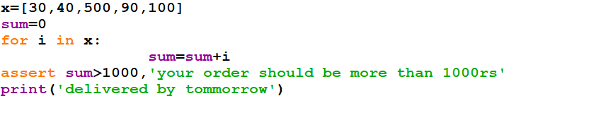
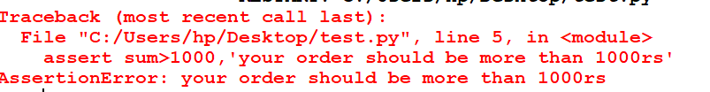
S. Durga Devi ,CSE,CBIT

Slide 41
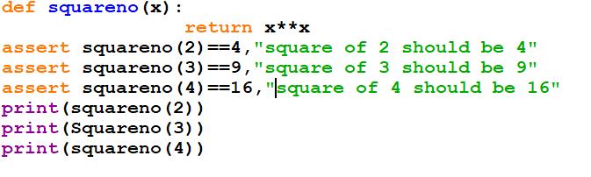

S. Durga Devi ,CSE,CBIT

Slide 42
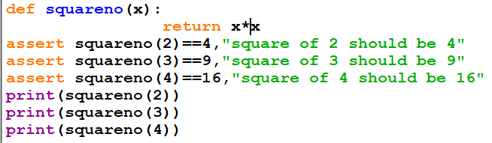

output
S. Durga Devi ,CSE,CBIT

